Slide 1

ALIEN NATION
EPHESIANS 2:11-22
GRACE EVANGELICAL SOCIETY
National Conference 2019

Slide 2
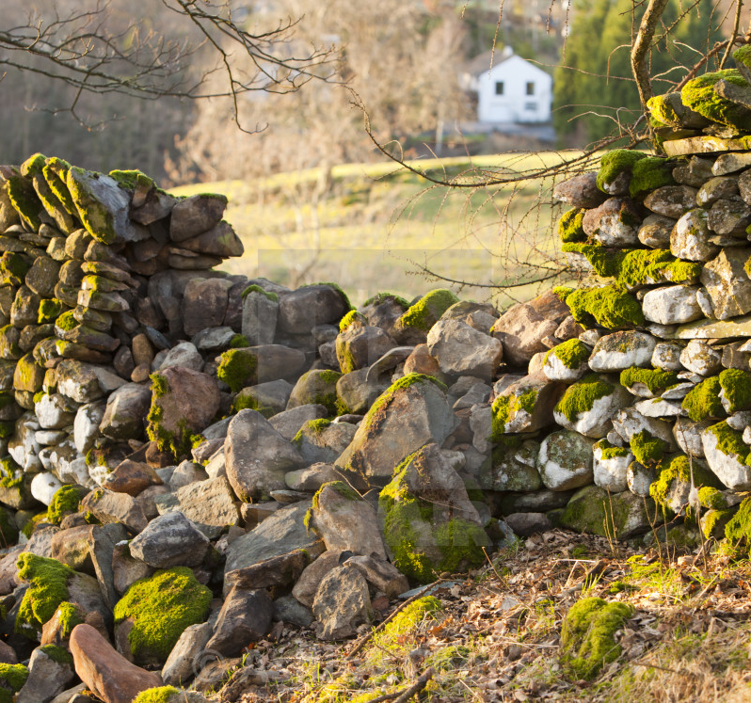
The Mending Wall

Slide 3

Great Wall of China

Slide 4
Hadrian’s Wall

Slide 5
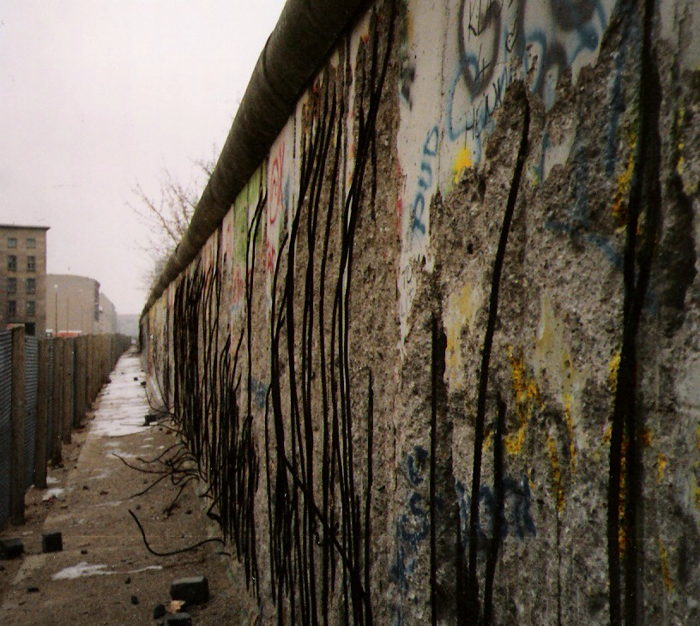
Berlin Wall

Slide 6
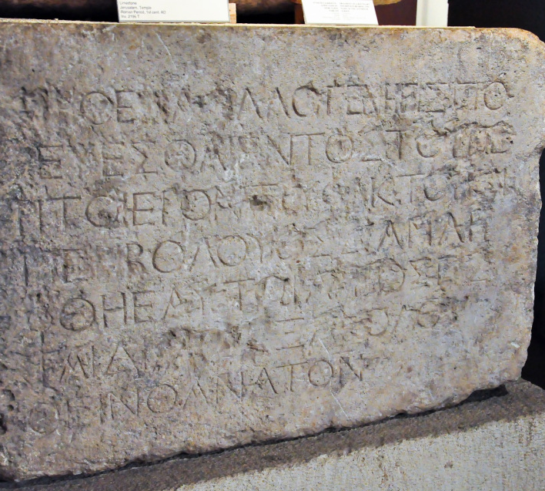
Court of Gentiles
No foreigner may enter within the balustrade around the sanctuary and the enclosure. Whoever is caught, on himself shall he put blame for the death which will ensue.”

Slide 7
Ephesians 2:11-22
1
2
3
ALIENATION
2:11-12
Curse
Ruin
RECONCILIATION
2:13-18
Cure
Remedy
UNIFICATION
2:13-18
Communion
Restoration

Slide 8
ALIENATION, 11-12
RACIAL, 11
“Uncircumcision”
Circumcision

Slide 9
ALIENATION, 11-12
SPIRITUAL, 12
Christless
Stateless
Friendless
Hopeless
Godless

Slide 10
RECONCILIATION, 13-19
Between Jew and Gentile, 13-15
Between People and God, 16-18

Slide 11
UNIFICATION, 19-22
Political, 19A
Familial, 19b
Spiritual, 20-22

Slide 12
REFLECTIONS

