Slide 1

“The Real Illuminati”
Ephesians 5:8b-21
GRACE EVANGELICAL SOCIETY
National Conference 2019

Slide 2
“The Real Illuminatti” – Ephesians 5:8b-21
I. Live brightly, 5:8b-10.
II. Live innocently, 5:11-14.
III. Live strategically, 5:15-21.

Slide 3
I. Live brightly, 5:8b-10.

Slide 4
A. Live as children of the light in the Lord, 8b-9.
Walk as children of light ⁹ (for the fruit of the Spirit is in all goodness, righteousness, and truth),
[Ephesians 5:8b-9, NKJV]

Slide 5
B. Discerning what pleases the Lord, 10.
¹⁰ finding out what is acceptable to the Lord.
[Ephesians 5:10, NKJV]

Slide 6
II. Live innocently, 5:11-14.

Slide 7
A. Do not participate in unfruitful deeds of darkness, 11a.
¹¹ And have no fellowship with the unfruitful works of darkness,
[Ephesians 5:11a, NKJV]

Slide 8
B. But rather expose them, 11b-12.
but rather expose them. ¹² For it is shameful even to speak of those things which are done by them in secret.
[Ephesians 5:11b-12, NKJV]

Slide 9

Travis Park Church, San Antonio, TX

Slide 10

Chick-fil-A banned from SAT airport

Slide 11
C. Wake up and reflect the light of Christ, 13-14.
¹³ But all things become visible when they are exposed by the light, for everything that becomes visible is light. ¹⁴ For this reason it says, “Awake, sleeper, and arise from the dead, and Christ will shine on you.”
[Ephesians 5:13-14, NASB]

Slide 12
III. Live strategically, 5:15-21.

Slide 13
A. Be constantly careful how you live, 15- 16.
¹⁵ Therefore be very careful how you live—not as unwise but as wise, ¹⁶ taking advantage of every opportunity, because the days are evil.
[Ephesians 5:15-16, NET]

Slide 14
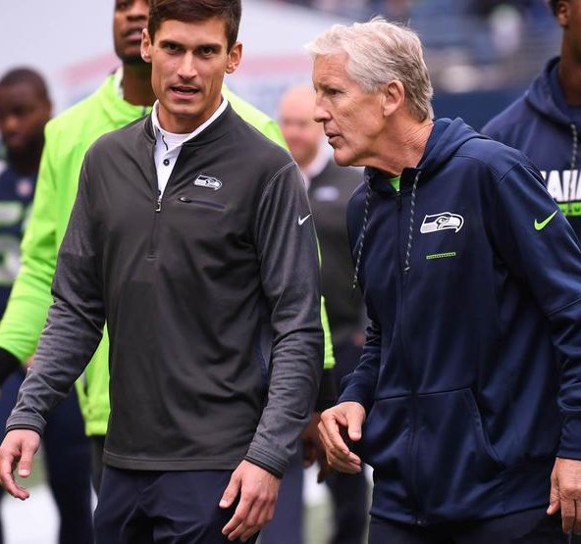
Ben Malcomson, Walk On

Slide 15
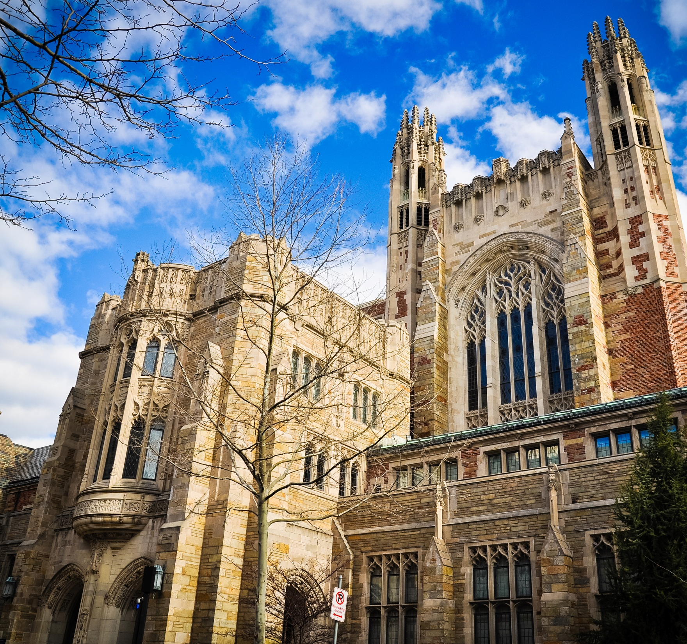
Yale University, Yale Law School
Originally founded “to know God in Jesus Christ and answerably lead a godly, sober life.”

Slide 16
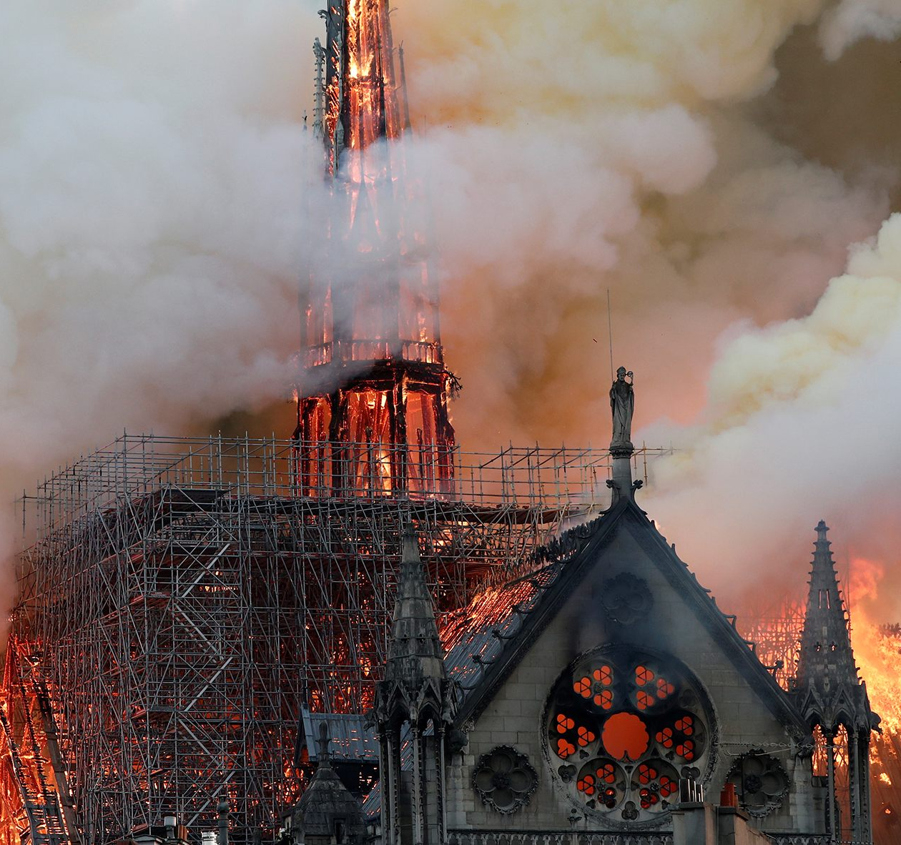
Notre Dame burns

Slide 17
B. Understand what the will of the Lord is, 17.
¹⁷ So then do not be foolish, but understand what the will of the Lord is.
[Ephesians 5:17, NASB]

Slide 18
C. Be continuously filled with the Spirit, 18-21.
¹⁸ And do not be drunk with wine, in which is dissipation; but be filled with the Spirit,

Slide 19
¹⁹ speaking to one another in psalms and hymns and spiritual songs, singing and making melody in your heart to the Lord, ²⁰ giving thanks always for all things to God the Father in the name of our Lord Jesus Christ, ²¹ submitting to one another in the fear of ^{[f]}God.
[Ephesians 5:18-21, NKJV]

Slide 20
Don’t let your light dim;
Turn up your light!

Slide 21
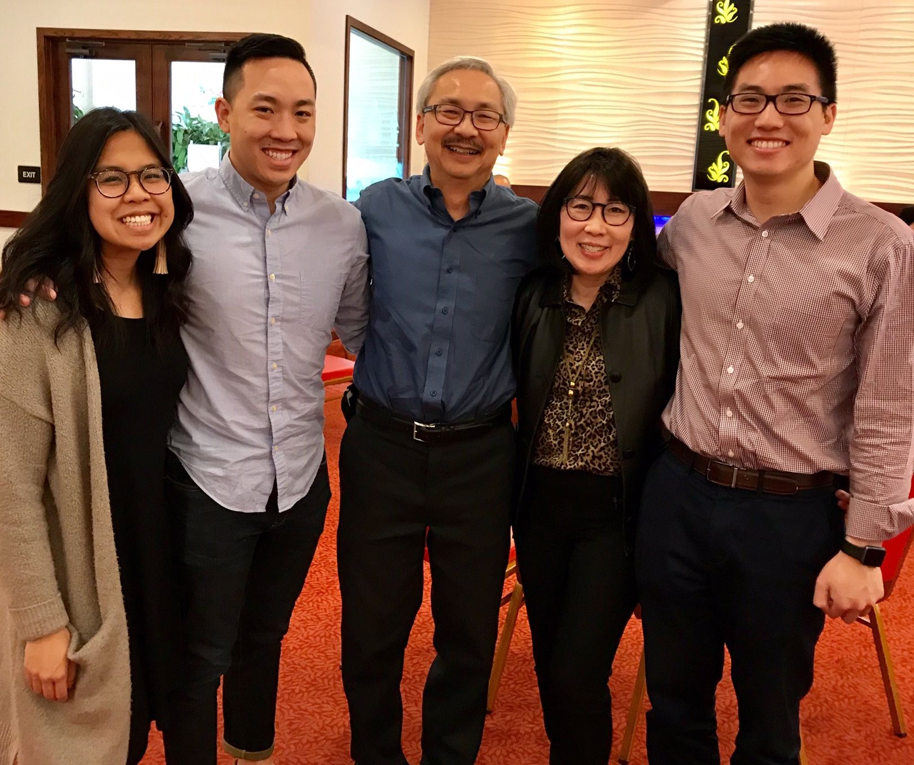
The Lee Illuminatti

